Slide 1





Smart contract development with solidity
Course Introduction
Smart Contract Development with Solidity
SoftUni Team
Technical Trainers
Software University
http://softuni.bg
Logos: https://www.ethereum.org/assets

Slide 2



Table of Contents
Course Objectives
Course Program
Trainers Team
Course Schedule
Exams and Evaluation
Learning Resources

Slide 3

Smart Contract Development with Solidity
Course Objectives & Program

Slide 4

Smart Contract Development with Solidity – Course Program
Blockchain functionality summary - intro to cryptocurrencies, decentralization concept, PoW vs PoS consensus, mining, Pros/cons, blockchain explorers
Introduction to Ethereum and smart contracts - Ethereum vs Bitcoin, Ethereum Virtual Machine, contract function and execution, gas & gas limit, contract example
Basics of contracts - structure, functions, events, state variables
Solidity data types - primitives, arrays, maps & their constraints

Slide 5
Smart Contract Development with Solidity – Course Program
Inheritance and multiple contracts - calling other contracts, inheriting
Working with contracts from applications: Web3 API - compiling, deploying, executing and reading data from contracts. Web app demo
Optimizing contracts - best practices on optimization, ‘optimize this’ assignments
Security in contracts and unit testing - common security pitfalls, building unit tests with the Truffle framework
Working on the practical projects
Project defense

Slide 6

The Trainers Team

Slide 7
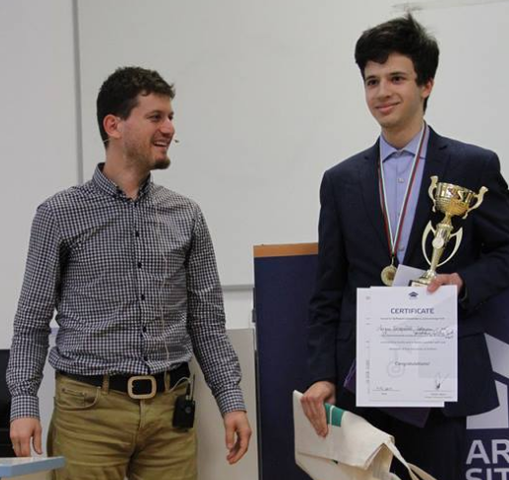
Trainers Team
Zvezdin Besarabov :
> 1.5 years of Blockchain and Solidity experience
Author of “Obitcoin” - decentralized cooperatives
Regular participant in IT competitions
https://github.com/Zvezdin

Slide 8

Trainers Team
George Spasov (feedback & homework assistance):
~1 year experience with Blockchain
Graduate of Consensys academy
>8 years experience Software developer
Co-founder of LimeChain blockchain development services company with many international clients

Slide 9

Smart Contract Development with Solidity: More Details
Duration, Languages, Technologies

Slide 10


Training Duration – Course Name(Required)
Lessons: ~27 hours (onsite + videos)
Including practical exercises (in class)
Project preparation: 3 hours (onsite) + at home
Schedule: Each Thursday, January –March 2018
Project defense: 31 March 2018

Slide 11



Why English?
Why the slides are in English?
English is the native language of the software engineers
Specific terminology should be in English
Translations are inaccurate and funny
Just learn English!
No excuses

Slide 12



Smart Contract Development with Solidity
Evaluation Criteria

Slide 13


Scoring System for “Course Name(Required)”
Project – 90%
Homework (exercises) – 10%

Slide 14
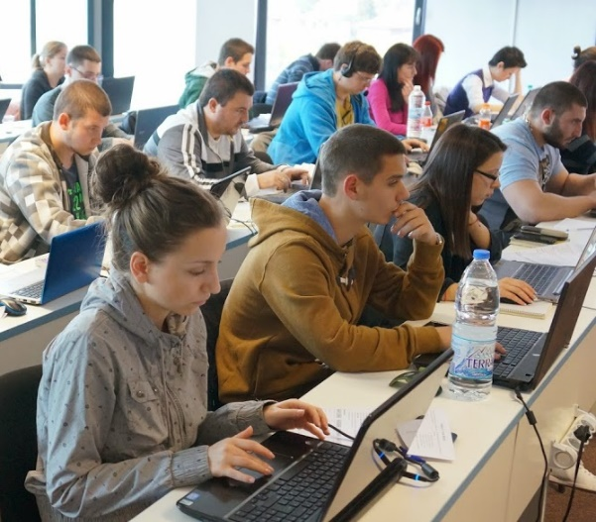

Smart Contract Development with Solidity Project
Practical project development throughout the course
The project is a smart contract
The score is based on the amount of completed project requirements
Requirements here: https://goo.gl/7Wh8qu
Must use the knowledge from the lectures

Slide 15

Homework Assignments
Doing your homework is very important!
Consistent practice or nothing
Each practical lesson is followed by onsite and homework exercises
Homework assignments are due in 6 days after each lecture
Must check 3 other people’s homework before receiving your points
I’ll upload the solutions afterwards

Slide 16










Resources
What We Need Additionally?

Slide 17



Course Web Site, Forum and FB Group
Official website:
Official discussion forum:
Official Facebook groups:
https://softuni.bg/trainings/1765/smart-contract-development-with-solidity
https://softuni.bg/forum/categories/120/smart-contract-development-with-solidity
https://www.facebook.com/groups/SmartContractDevelopmentwithSolidityJanuary/

Slide 18

Course Slides and Videos
All lecture slides, videos, homework assignments, projects and other resources are uploaded online
Visit the course website to access the course resources

Slide 19

Software University Learning System (SULS)
Software University Learning System (SULS)
www.softuni.bg
Important resource for students
Homework submissions
Homework check-up
Exams and results
Reports about your progress
…

Slide 20
Required Software
Software needed for this course:
A browser (I’d guess you have one but still). Recommend chrome.
Windows >= 7, Mac or Linux
Node Package Manager (NPM)
Git source control (for your project)
We’ll install a few NPM packages down the road
Our Solidity IDE is online: http://remix.ethereum.org/

Slide 21




Summary
Training program
Solidity structure, functions, types, optimization, security and interaction
Practical project
Do at home after lectures, complete the requirements and later defend it
Learning resources
Slides, videos, software

Slide 22







Course Overview
https://softuni.bg/trainings/1765/smart-contract-development-with-solidity

Slide 23
License
This course (slides, examples, demos, videos, homework, etc.) is licensed under the "Creative Commons Attribution-NonCommercial-ShareAlike 4.0 International" license

Slide 24





Trainings @ Software University (SoftUni)
Software University – High-Quality Education, Profession and Job for Software Developers
softuni.bg
Software University Foundation
http://softuni.foundation/
Software University @ Facebook
facebook.com/SoftwareUniversity
Software University Forums
forum.softuni.bg

